Slide 1
Module 5: Feedback to Advance Student Argumentation
“Argument, in short, is the essence of thought.”
Schmoker & Graff (2011)
“Argument is the soul of an education”
Bridging Math Practices
Math-Science Partnership Grant

Slide 2
Opening Activity

Slide 3


The Salary Problem
Bad news! You get a pay cut of 10%. (And for quite some time, your pay doesn’t change.)
Your boss comes to you one day. “Good news! I’ve been fighting for a raise for you and I got you a 10% raise! You’re back to your old salary!”
Is your boss right? Show how you know.
Try to show it in as many different ways as you can.

Slide 4
Module Objectives
Develop a deeper understanding of argumentation and its potential in the math classroom.
Further develop strategies to support students in generating, extending and sharing their arguments (and understanding) as a discussion unfolds.
Analyze student verbal and written mathematical arguments, using the structure of an argument, in order to provide feedback (feedforward) to support mathematical argumentation.

Slide 5
Providing Feedfoward
We use feedforward to help students improve their ability to express arguments and to support them in developing conceptual understanding.
Feedforward provides comments that highlight aspects of the response that are part of a competent performance
Feedforward provides comments that indicate “next steps” that would help improve the quality of the work
Notes:
Insert references Student Assessment FOR Learning

Slide 6
Theme: Providing Feedforward
Role Play Activity
Analyzing Written Work
Verbal feedforward in real-time
Help students express and develop their arguments – and conceptual understanding
Help students hear others’ arguments; engage others’ arguments
Written feedforward
Help students express and develop their arguments – and conceptual understanding
Help students get better at recording/writing their arguments

Slide 7
A Pedagogical Model to Support a Culture of Thinking
New question(s)
Solidify and/or refine new meanings
Generate ideas
Press on and develop ideas collaboratively
Elicit and
Publicize ideas

Slide 8
Number Trick Task
Jessie discovers a cool number trick. She thinks of a number between 1 and 10, she adds 4 to the number, doubles the result, and then she writes this answer down. She goes back to the number she first thought of, she doubles it, she adds 8 to the result, and then she writes this answer down.
Here is an example:
Jessie thinks of the number. 5
She adds 4 to her number 5 + 4 = 9
She doubles the result 9 x 2 = 18
She writes down her answer. 18
Jessie goes back to the number she thought of. 5
She doubles her number. 5 x 2 = 10
She adds 8 to the result. 10 + 8 = 18
She writes down her answer. 18
Will Jessie’s two answers always be equal to each other for any number between 1 and 10? Explain your reasoning.
Does your explanation show that the two answers will always be equal to each other for any number (not just numbers between 1 and 10)? Explain your answer.
Please do this problem!
Optional: use the organizer to help you record your argument

Slide 9
Role Play Activity
STUDENT:
Closely examine the student work sample you have been given. Try to act out the thinking and persona suggested by your work sample. In the role play, you should be the student who wrote that work.
Complete the organizer for constructing an argument based on the student work sample you have been given. Do your best to fill out each section as you think your student would have.
During the group discussion time, try your best to think like and be your student. If you do not have enough information from the student work to know how your student would respond, you can make an educated guess, or you can say, “I don’t know.”

Slide 10
Role Play Activity
TEACHER:
Make sense of student thinking using their written work and discussion.
Focus the discussion among the pair or small group of students.
Your major objective is to support student learning, which may include, clarifying students’ thinking and supporting them to extend and elaborate their mathematical arguments.
  It is okay if the group does not have time to fully get a consensus on their group argument. Your focus is on understanding their thinking and helping them engage with the thinking of others.

Slide 11
Role Play Activity- Process
Students focus on individual arguments
Students discuss and further develop ideas with teacher assistance
Students make sense of one another’s ideas and come to new understandings

Slide 12
Role Play – Debrief with Groups
What kind of feedforward from the teacher (or students) seemed productive for individuals or the group?
  What did you learn about supporting a discussion?
As the teacher, what were you focused on when formulating your questions or comments?
As a student, what questions, prompts or comments helped you express or develop your ideas?
How does this activity apply to your classroom teaching situation?
These questions are meant to be generative.
You don’t have to discuss each one! And please feel free to pose and discuss others of interest to your group.

Slide 13
Role Play Wrap-Up
(Whole Group)
What stood out to you from engaging in the Number Trick Role Play Activity?
What are some distinctions between facilitating students in a general discussion and facilitating students engaged in argumentation?

Slide 14
Analyzing Student Work
Opportunities for Feedforward

Slide 15



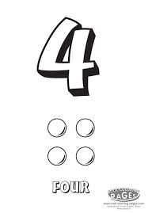


Number Trick task
Analyzing student work
Opportunity to use our language of claims, warrants and evidence to analyze student work
Example of a task targeting the develop-ment of a core conceptual understanding
Think of a number between 0 and 10 (inclusive)….

Slide 16
Your task…
Identify the argument
  What is the claim?
  What’s the evidence the student offers?
  What’s the warrant(s) that links the evidence to the claim?
Critique the argument
  What are strengths of what the student did?
  Is the approach (chain of reasoning) mathematically sound? Are there logical gaps? Must the reader fill in connections or pieces of evidence?
Consider conceptual understanding
  What can you infer about the student’s (developing) understanding of the distributive property?

Slide 17
Goal: make progress on these questions
How does argumentation help us promote conceptual understanding of important ideas (e.g., the distributive property)?
How does argumentation reveal students’ understanding of important ideas (here, the distributive property)?
How does our work getting better at identifying the claim, evidence and warrant help us give feedback and feedforward to students on their arguments?

Slide 18
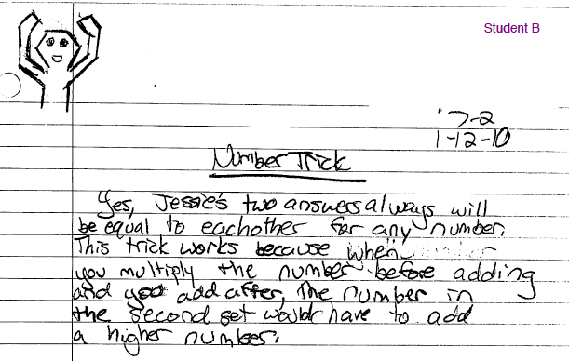
Let’s do one together: Student B
Analyze. Critique. Evidence of Conceptual Understanding.

Slide 19
Student B
Analyze. Critique. Evidence of Conceptual Understanding.
Claim:
Warrant:
Evidence:

Slide 20
Student B
Analyze. Critique. Evidence of Conceptual Understanding.
Claim: Yes
Warrant: General appeal to how operations work (if you add after multiplying, you have to add more than if you add first).
Evidence: none
Note: We’ve allowed that the student is talking about multiplication and adding in the context of positive, whole numbers.

Slide 21
Student B
Analyze. Critique. Evidence of Conceptual Understanding.
Claim: Yes
Warrant: General appeal to how operations work (if you add after multiplying, you have to add more than if you add first).
Evidence: none
Critique: The student offers an over-generalized reason about multiplying and then adding, without considering the fact that the added quantity for the second process must be double what is added in the first process for this particular trick.

Slide 22
Student B
Analyze. Critique. Evidence of Conceptual Understanding.
Evidence of CU: Student is beginning to make sense of how multiplying a sum is different from multiplying one number and then adding. Recognizes that when ”adding after” you must add a “higher” number. Needs to be pushed to consider the magnitude of the quantities and articulate why.

Slide 23
Your Turn!
Identify the argument
  What is the claim?
  What’s the evidence the student offers?
  What’s the warrant(s) that links the evidence to the claim?
Critique the argument
  What are strengths of what the student did?
  Is the approach (chain of reasoning) mathematically sound? Are there logical gaps? Must the reader fill in connections or pieces of evidence?
Consider conceptual understanding
  What can you infer about the student’s (developing) understanding of the distributive property?

Slide 24
Debrief

Slide 25


Providing Written Feedfoward
Stars and Stairs
Stars: comments that highlight aspects of the response that are part of a competent performance
Stairs: comments that indicate “next steps” that would help improve the quality of the work

Slide 26
Stars or stairs?
Very nice job. Good lettering.
Check your math.
In your diagram, I can see the connection you made between the pattern and how you found your answer. Nice.
You’ve solved this for n=5. Keep thinking! How can your approach help you think about other ns.

Slide 27
Student B: Stars and Stairs!
Stars:
Stairs:

Slide 28
Student B: Stars and Stairs!
Stars: You did a nice job considering how the order of multiplying adding matters, and thinking about ALL input numbers.
Stairs: Be more specific about how MUCH you have to add: If you double first and then add, how do the numbers you add in the first and second process compare? (And why?)

Slide 29
Stars & Stairs!
Select 2 student work samples
STAR! Identify what the student is doing well with respect to argumentation. Write a comment that conveys to the student what s/he is doing well.
STAIR! Identify an area of improvement for the student with respect to argumentation. Write a learning promoting comment that conveys to the student how s/he might grow.

Slide 30

Your Turn:
Look at the Student Work
Analyze the argument
  Identify the argument. What is the claim? What’s the evidence the student offers? What’s the warrant(s) that links the evidence to the claim?
Critique the argument
  Is the approach (chain of reasoning) mathematically sound Are there logical gaps? Must the reader fill in connections or pieces of evidence? What are the strengths of what the student did?
Consider (demonstrated) conceptual understanding
    What can you infer about the student’s (developing) understanding of the distributive property?
THEN
4. Formulate your Stars & Stairs
Notes:
This slide may be useful if you are doing the PLC Format, as it asks participants to analyze the work samples AND write Stars & Stairs comments at the same time.

Slide 31
Debrief
What questions have come up for you?
What was hard about this activity? What was easy?

Slide 32
Progress on these questions
How does argumentation help us promote conceptual understanding of important ideas (e.g., the distributive property)?
How does argumentation reveal students’ understanding of important ideas (here, the distributive property)?
How does our work getting better at identifying the claim, evidence and warrant help us give feedback and feedforward to students’ arguments?

Slide 33
Bridging to Practice

Slide 34
Reflect
What will count in your classroom for a valid argument? (What qualities or criteria are important to you?)
How will these criteria be communicated to students? (What vocabulary and meaning making must be built up around argumentation?)
What do you expect at the beginning of the year? Where will growth be? (It may help to think of a question that involves reasoning/argumentation that you might pose to students. Consider how the students might respond at the beginning of the year? What growth might you see over the year?)

Slide 35
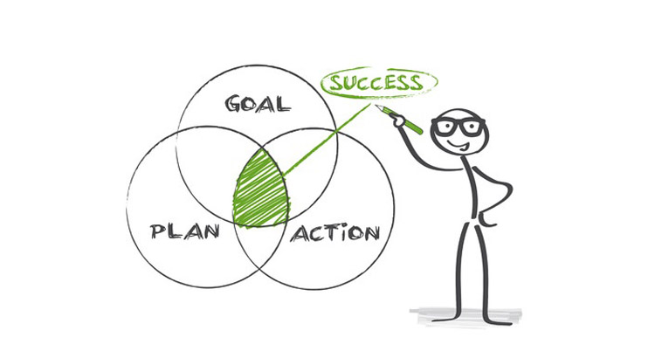

Action Plan Activity
Part 1: By the end of the school year…
At the start of the school year…
Part 2: Support a culture of thinking by...
Part 3: What happens if...
Part 4: Plan to share...

Slide 36

“Photo Album” Activity
Create a personal ”Photo Album” of Math Argumentation Resources from your Bridges experience

Slide 37


Next Steps
Complete each of the following statements based on your experience with the Bridging Practices Among Mathematics Educators’ 5 modules
If you had to choose one idea from any of our modules to share with your grade-level colleagues who didn’t participate, what would it be?
Think of one thing you have learned and tell us how this idea has changed or will change the way you use mathematical argumentation during math instruction.
Think about how this PD fits into your own personal growth as a mathematics teacher. What is one specific action you will take this summer/fall to implement your new learning?

Slide 38

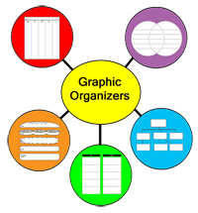
Concept Map:
A graphic organizer to help represent and make connections between ideas

Slide 39
Concept Mapping & Reflecting
Let’s reflect on the present & past sessions
Group Concept Maps (__ min)
At your tables:
Work together to create a concept map.
Use the words/phrases provided that represent mathematical argumentation ideas we have explored throughout the five modules.
You do not need to use all of the words/phrases provided.
You may add your own words/phrases.
Please use markers to highlight you connections.

Slide 40
Acknowledgements
Bridging Math Practices Project was supported by a Math-Science Partnership Continuation Grant from the Connecticut State Department of Education, 2015-2016
The initial 2014-2015 Bridges project was a collaborative project among UConn, Manchester Public Schools, Mansfield Public Schools, and Hartford Public Schools
UConn: Megan Staples (PI), Jillian Cavanna (Project Manager)
Lead Teachers: Catherine Mazzotta (Manchester), Michelle McKnight (Manchester), Belinda Pérez (Hartford) Teresa Rodriguez (Manchester)
We would like to thank the CT State Department of Education for their generous support of this work and would like to thank all our participants, across cohorts, whose contributions to these materials are many.

