Slide 1
Module 3
Focus on Implementation – Norms and Routines to Prompt and Support Argumentation
“A culture of thinking produces the feelings, energy, and even joy that can propel learning forward and motivate us to do what at times can be hard and challenging mental work.” ~Ron Ritchhart
Bridging Math Practices
Math-Science Partnership Grant

Slide 2
Opening Activity
Notes:
See PD Facilitation Guide for more information about potential Opening Activities

Slide 3
Opening Activity: Animal Populations Task
Original problem from illustrativemathematics.org
Suppose P and Q give the sizes of two different animal populations, where Q > P. In (a) – (d), say which of the expressions is larger. Briefly explain your reasoning in terms of the two populations.
(a) P + Q and 2P
(b) (Q – P)/2 and Q – P/2
(c) and
(d) P + 50t and Q + 50t
Private Think Time
Structured Pairs-Share

Slide 4
Module Objectives
Develop a deeper understanding of argumentation and its potential in the math classroom.
Examine norms and routines that can support mathematical argumentation in the classroom
Develop an understanding of a pedagogy of inquiry to support mathematical argumentation in the classroom

Slide 5
Brainstorm
What classroom norms support a culture of thinking and mathematical argumentation?

Slide 6
Why watch videos?
Allows us to dig deeply into a moment
“Slows down” classroom life, and lets us consider it from multiple view points, multiple times
Productive for helping us think about students’ interactions and how teacher’s work influences student’s participation and thinking
Note: not as good for questions about patterns, such as who typically participates
Notes:
Narrated powerpoint discussing how to productively view classroom video available at https://youtu.be/dCs8dxhzx6c [1:46]

Slide 7
Video Set Up
Six students are from a Grade 6 class from 2014-2015.
Working with Michelle McKnight, an interventionist in addition to their regular math class, one day per week.
Ms. McKnight worked with them in their class to provide support 3 days a week.
One of Ms. McKnight’s goals was to support math discourse and CCSS-M Mathematical Practice 3.

Slide 8
Tips
Focus on the argumentation
What is the role of argumentation in this classroom?
What purpose does it serve in this lesson?
Focus on the student thinking
How are they making sense of the mathematics?

Slide 9
Guiding Questions for Video
What moves do you see the teacher making to help promote a culture of thinking?
What do you see students saying or doing that relates to a culture of thinking?
What norms may have been previously established in this class to support this interaction? What evidence does the video provide?

Slide 10
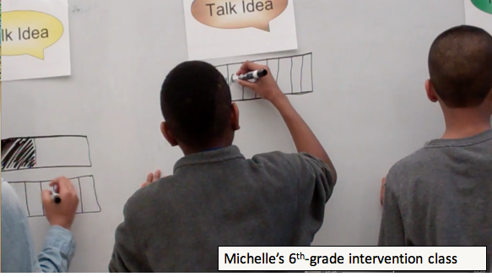
Classroom Norms for Argumentation
https://youtu.be/I1nzLeGpdDc
Notes:
Video, with subtitles, is available at https://youtu.be/I1nzLeGpdDc

Slide 11
Debrief of Video
What moves do you see the teacher making to help promote a culture of thinking?
What do you see students saying or doing that relates a culture of thinking?
What norms may have been previously established in this class to support this interaction? What evidence does the video provide?
What questions would you want to ask the teacher of this class?

Slide 12
Norms to Support A Culture of Thinking – Summary thoughts
Notes:
These are potential take aways – you may wish to ask participants for take aways or offer some key ones you expect will arise. Other potential points of discussion and take aways are outlined in the Facilitation Guide.
There are many different ways to do this in your classroom. You need to consider your particular students.
All students can engage in argumentation and need opportunities to!
It’s very important to have students both willing to share their ideas and being able to listen to other’s ideas, and think about someone else’s mathematics.

Slide 13
Shifting Gears to
Pedagogical Routines
Definition
Routine – a sequence of actions regularly followed

Slide 14
Brainstorm: Pedagogical Routines
What routines do you know that help support argumentation and a culture of thinking?

Slide 15
Brainstorm: Pedagogical Routines
Ideas
Ideas

Slide 16
A Pedagogical Model to Support a Culture of Thinking
New question(s)
Solidify and/or refine new meanings
Generate ideas
Press on and develop ideas collaboratively
Elicit and
Publicize ideas

Slide 17
Problem Solving Tasks: Why do tasks together?
Provide a common math-teaching-and-learning experience for reflection and discussion
Opportunity to discuss tasks and task implementation
Exposure to/discussion of some teaching strategies
Opportunities to see how others think
To learn more math (connections); engage in productive struggle
For fun! ☺

Slide 18
Let’s Begin...
A pedagogical routine to support a culture of thinking:
Talk Frame Routine

Slide 19
Talk Frame Routine
Think
Individual Think Time
Group Think Time
Talk Idea
Talk Idea
Talk Idea
Sharing some idea with the whole group
We Understand
Summary of the mathematically valid conclusion agreed upon by the class
Exploring Shape Games: Geometry with Imi and Zani, by M. K. Gavin, T. M. Casa, S. H. Chapin, and L. J. Sheffield. Copyright © 2012, by Kendall Hunt Publishing Company

Slide 20
Remember our Community Agreements
Notes:
Insert your community agreements here, or reference them. You might also choose to highlight a subset of them that are most closely related to supporting collaborative problem solving.

Slide 21
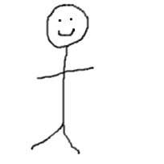
Think

Slide 22
Chain of Flowers
Pattern task
Figure 1
Figure 2
Figure 3
Draw Figure 5. How many tiles does it have?
How many tiles will the 25th figure have? How do you know?
How many tiles are in the nth figure? How do you know?

Slide 23
Sharing Ideas with Whole Group
Talk Idea
Talk Idea
Talk Idea

Slide 24
The Take-Aways
We Understand
Notes:
Some “We Understands” that have been generated in relation to this problem, as implemented with various groups
There is an strong connection between an exact answer to a problem and a general solution
It is important to label parts of an expression or diagram to show the relationship that they have to each other
Variables, symbols and diagrams can all be used to represent patterns
Multiple approaches may be used to solve a problem

Slide 25
Reflecting on the Talk Frame Routine
Think
Thoughts, comments, questions
Consider: What might the Talk Frame, or a similar routine, help you do?
What questions do you have?
Talk Idea
We Understand

Slide 26
How does the Talk Frame Routine support the Pedagogical Model for a Culture of Thinking?
Think
New question(s)
Talk Idea
Solidify and/or refine new meanings
Generate ideas
We Understand
Press on and develop ideas collaboratively
Elicit and
Publicize ideas

Slide 27
Talk Frame Routine
Think
Question worded using student accessible phrasing
Talk Idea
Notes representing students’ ideas
(These include correct ideas as well as misconceptions. Also, the number of “talk idea” sections used will vary according to the lesson, student contributions, and teacher’s decisions about how to group ideas. The teacher can also choose to add in a particular “talk idea.”)
We Understand
Summary of the mathematically valid conclusion agreed upon by the class
Exploring Shape Games: Geometry with Imi and Zani, by M. K. Gavin, T. M. Casa, S. H. Chapin, and L. J. Sheffield. Copyright © 2012, by Kendall Hunt Publishing Company

Slide 28
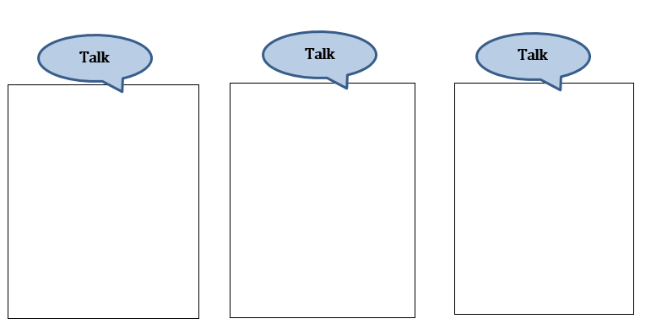
Talk Fame Routine Template

Slide 29
Bridging to Practice

Slide 30
Bridging to Practice:
Talk Frame Routine Mini Lesson
With your team, select one of these problems
Individually work the problem
With your team, talk about the problem
What’s worth discussing in a mini-lesson related to this problem?
What would make a good “talk frame” question?
Use the Talk Frame Routine template to help you prepare a mini-lesson
Talk with your team about how you will teach this mini-lesson (who will do what, etc.)
Teach the mini-lesson to your assigned team

Slide 31
Remember the Talk Frame Routine
Think
Question worded using student accessible phrasing
Talk Idea
Notes representing students’ ideas
(These include correct ideas as well as misconceptions. Also, the number of “talk idea” sections used will vary according to the lesson, student contributions, and teacher’s decisions about how to group ideas. The teacher can also choose to add in a particular “talk idea.”)
We Understand
Summary of the mathematically valid conclusion agreed upon by the class
Exploring Shape Games: Geometry with Imi and Zani, by M. K. Gavin, T. M. Casa, S. H. Chapin, and L. J. Sheffield. Copyright © 2012, by Kendall Hunt Publishing Company

Slide 32
Closure

Slide 33
Reflecting on Norms in your own Practice
Which norms/routines do you see yourself using at the beginning of the school year? Why?
All students can and should have opportunities to participate in argumentation. How might that work differ from class to class, or across groups of students with different needs?
What have you tried already that has worked well in your classroom?
Notes:
Slide that could be used during closure or earlier in the session, as desired

Slide 34
Acknowledgements
Bridging Math Practices Project was supported by a Math-Science Partnership Continuation Grant from the Connecticut State Department of Education, 2015-2016
The initial 2014-2015 Bridges project was a collaborative project among UConn, Manchester Public Schools, Mansfield Public Schools, and Hartford Public Schools
UConn: Megan Staples (PI), Jillian Cavanna (Project Manager)
Lead Teachers: Catherine Mazzotta (Manchester), Michelle McKnight (Manchester), Belinda Pérez (Hartford), and Teresa Rodriguez (Manchester)
We appreciate greatly the CT State Department of Education for supporting this work and would like to thank all our participants, across cohorts, whose contributions to these materials are many.

