Slide 1
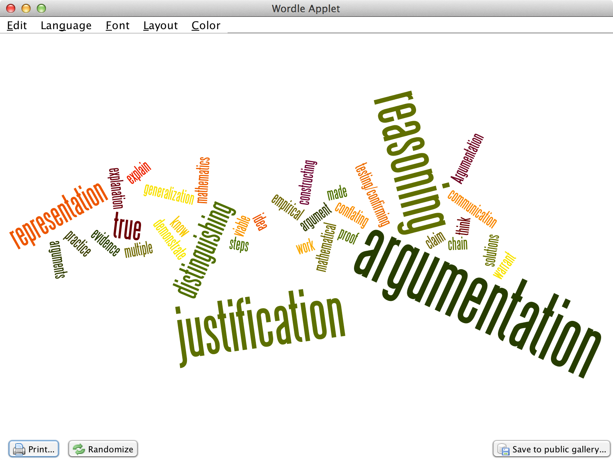
Module 1: What is Argumentation?
Bridging Math Practices
Math-Science Partnership Grant

Slide 2
Opening Activities: Getting to Know Our Group
Notes:
See PD Facilitation Guide for more information about potential Opening Activities

Slide 3
Establishing Community Agreement
Guiding Question: What are some of the things that are important for a group to agree to in order for that group to work well together?
1: Think (2-3 min.)
Think about 2 or 3 things that are necessary for a group to work well together and jot them down on a piece of paper.
2: Share (2-3min.)
In small groups, share your thoughts with your group members and decide which you feel are important enough to propose to the whole group for inclusion into our community agreement.
3: Review
Review and agree on proposals. Understand that we may make revisions and/or additions that might be necessary.
4: Write and Post (and Revisit)
The reporter/recorder will write them on a sentence strip and post on the wall to make them visible and public.
Notes:
Purpose: To set the ground rules that will help us stay focused on the important work we are about to engage in.
MATERIALS NEEDED:
tape, sentence strips, markers

Slide 4
Argumentation
Mathematical argumentation involves a host of different “thinking” activities: generating conjectures, testing examples, representing ideas, changing representation, trying to find a counterexample, looking for patterns, etc.
Notes:
Consider discussing how mathematical argumentation might be a valuable activity in the mathematics classroom. [Time is also allocated to discuss the purposes of argumentation in the classroom in Module 2.]

Slide 5
Standards of Mathematical Practice
1. Make sense of problems and persevere in solving them.
2. Reason abstractly and quantitatively.
3. Construct viable arguments and critique the reasoning of others.
4. Model with mathematics.
5. Use appropriate tools strategically.
6. Attend to precision.
7. Look for and make use of structure.
8. Look for and express regularity in repeated reasoning.

Slide 6
How do mathematical practices relate to student reasoning?
CCCSM MP 3 – Construct viable arguments and critique the reasoning of others. The practice begins, “Mathematically proficient students understand and use stated assumptions, definitions, and previously established results in constructing arguments …”

Slide 7
Thinking is the hardest work there is, which is probably the reason why so few engage in it. - Henry Ford
Teachers Will Be Able To:
Develop a deeper understanding of argumentation and its potential in the math classroom.
Analyze mathematical arguments within the three components of an argument.

Slide 8
Overarching Guiding Questions:
What is a mathematical argument? What “counts” as an argument?
What is the purpose(s) of argumentation in mathematics? In the math classroom?
What does student argumentation look like at different levels of proficiency?
Notes:
MODULE 1: emphasis on what a mathematical argument is.

Slide 9
A Mathematical Argument
A Mathematical Argument is…
A sequence of statements and reasons given with the aim of demonstrating that a claim is true or false
A Mathematical Argument is not…
An explanation of what you did (steps)
A recounting of your problem solving process
Explaining why you personally think something is true for reasons that are not necessarily mathematical (e.g., popular consensus; external authority, intuition, etc. It’s true because John said it, and he’s always always right.)

Slide 10
Let’s take a look…
Abbott & Costello: 7 x 13 = 28
https://www.youtube.com/watch?v=xkbQDEXJy2k
Notes:
Are they making viable mathematical arguments? Why or why not?

Slide 11
Your Turn...
When you add any two consecutive numbers, the answer is always odd.
Is this statement true or false?
Write a mathematical argument to support your claim.

Slide 12
Your Turn...
When you add any two consecutive numbers, the answer is always odd.
Share your arguments with your group.
What similarities and differences do you notice?

Slide 13
Structure of an Argument
WHAT?
What is your response?
WHY? / HOW?
Why is this true? How do you know this is true?
What mathematical WORK related to the problem will support your response?
What mathematical RULES will support your work and your response?

Slide 14
Analyzing Student Arguments on the Consecutive Sums Task
You have 4 sample student responses to the Consecutive Sums Task.
For each student argument:
Discuss the student’s argument.
Determine if the argument shows the claim is true.
Notes:
NOTE TO FACILITATORS:
You may choose to introduce the language of Claims, Warrants and Evidence now (see next slides) or at a later point.
Once introduced, ask participants to try to use this language to make sense of the strengths and weaknesses of the responses.

Slide 15
When you add any two consecutive numbers, the answer is always odd.
Micah’s Response
5 and 6 are consecutive numbers, and 5 + 6 = 11 and 11 is an odd number.
12 and 13 are consecutive numbers, and 12 + 13 = 25 and 25 is an odd number.
1240 and 1241 are consecutive numbers, and 1240 +1241 = 2481 and 2481 is an odd number.
That’s how I know that no matter what two consecutive numbers you add, the answer will always be an odd number.

Slide 16
Example – Analyzing the Structure
Micah’s Response
5 and 6 are consecutive numbers, and 5 + 6 = 11 and 11 is an odd number.
12 and 13 are consecutive numbers, and 12 + 13 = 25 and 25 is an odd number.
1240 and 1241 are consecutive numbers, and 1240 +1241 = 2481 and 2481 is an odd number.
That’s how I know that no matter what two consecutive numbers you add, the answer will always be an odd number.
Evidence
3 examples that fit
the criterion
Warrant
(implicit) because if it
works for 3 of them,
it will work for all
Claim

Slide 17
When you add any two consecutive numbers, the answer is always odd.
Roland’s Response
The answer is always odd.
A number + The next number =
An odd number
There’s always one left over when you put them together, so it’s odd.

Slide 18
When you add any two consecutive numbers, the answer is always odd.
Angel’s Response
Consecutive numbers go even, odd, even, odd, and so on. So if you take any two consecutive numbers, you will always get one even and one odd number.
And we know that when you add any even number with any odd number the answer is always odd.
That’s how I know that no matter what two consecutive numbers you add, the answer will always be an odd number.

Slide 19
When you add any two consecutive numbers, the answer is always odd.
Kira’s Response
Consecutive numbers are n and n+1.
Add the two numbers:
n + (n+1) = 2n + 1
You get 2n + 1 which is always an odd number, because an odd number leaves a remainder of 1 when divided by 2. (2 goes into 2n + 1 n times, with a remainder of 1)

Slide 20
Comments on the approaches
Example based (Micah)
May not be enough to PROVE a claim
Narrative (Angel)
Stated warrant may also require justification
Pictorial (Roland)
Can be strong evidence but insufficient warrant
Symbolic (Kira)
Can be strong evidence but insufficient warrant

Slide 21
Structure of an Argument
CLAIM
WHAT?
What is your response?
WHY? / HOW?
Why is this true? How do you know this is true?
EVIDENCE
WARRANT
What mathematical WORK related to the problem will support your response?
What mathematical RULES will support your work and your response?
Notes:
We draw the language of claims, warrants and evidence from Toulmin (1958), The Structure of Arguments.

Slide 22
Structure of an Argument
CLAIM WHAT?
Your answer, result, or solution
What you believe to be true (or false)
Your stance or position to be supported
EVIDENCE
WHY / HOW?
Math work that can help support your claim
Evidence can take the form of equations, graphs, tables, diagrams, computations, and even words
WARRANT
WHY / HOW?
Math rules that can help support your claim
Warrants are often general, applying to many situations;
warrants can be definitions, previously proven theorems, or other established truths

Slide 23
Analyzing Student Arguments on the Consecutive Sums Task
Work through one of the student work samples together with your group
Use the CLAIMS, WARRANTS, EVIDENCE vocabulary
Think about the strengths and weaknesses of each argument.
Mark on the student work samples handouts
Highlight and make notes about what people notice.

Slide 24
Reflection Questions
How does your argument compare to the student samples?
How would you modify your work to make a stronger argument?

Slide 25
Bridging to Practice
Notes:
See PD guide for suggestions on Bridging-to-Practice activity(s) for PLC and Workshop formats.

Slide 26
Bridging to Practice
Protocol-Guided Student Work Sample Sorting Activity
Materials: Protocol and Set of Student Work Samples
Process:
Individual sort
Group discussion and group sort
Full group discussion/debrief
Purposes: protocols help organize professional conversations
help maintain focus on shared goals (for depth); provide time limits to ensure conversation covers required ground (for breadth and completeness)
encourage collaboration, active listening, and respectful dialogue that includes differences of opinions
Notes:
Purposes adapted from http://edglossary.org/protocols/

Slide 27
Closure

Slide 28
Acknowledgements
Bridging Math Practices Project was supported by a Math-Science Partnership Continuation Grant from the Connecticut State Department of Education, 2015-2016
The initial 2014-2015 Bridges project was a collaborative project among UConn, Manchester Public Schools, Mansfield Public Schools, and Hartford Public Schools
UConn: Megan Staples (PI), Jillian Cavanna (Project Manager)
Lead Teachers: Catherine Mazzotta (Manchester), Michelle McKnight (Manchester), Belinda Pérez (Hartford), and Teresa Rodriguez (Manchester)
We appreciate greatly the CT State Department of Education for supporting this work and would like to thank all our participants, across cohorts, whose contributions to these materials are many.

